Slide 1
Array of Objects
Notes:
In a real sofware, files are ways to store data of a program. Data in a file can be binary bytes, characters, and even binary data of objects belonging to a specific class. Depending on storing formats, read from and write data to a file are different. So, the java.io package supplies APIs for managing directories and files.

Slide 2
Objectives
basic operations supported by an array.
print all the array elements(objects)
Adds an object at the given index.
Deletes an object at the given index.
Searches an object using the given index or by the value.
Updates an object at the given index.

Slide 3
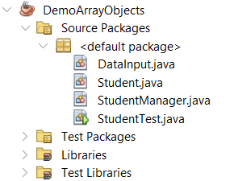
Lab
Create a Java console application to manage student information including id, full name, date of birth and gpa then perform the following functions: add new a student, find students by id, view list of students by descending gpa and update student information.

Slide 4
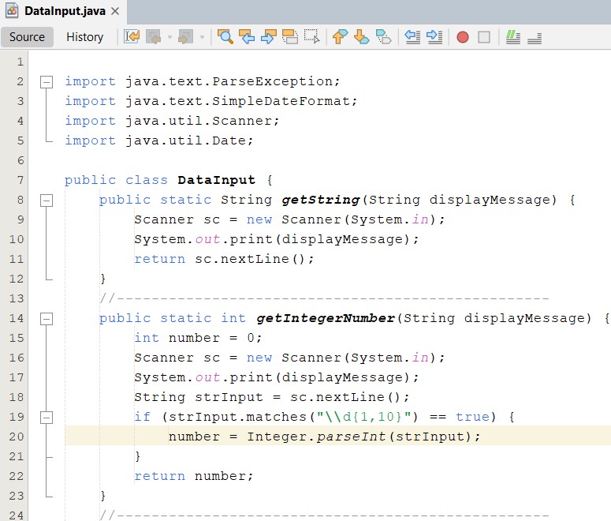
Lab
Write codes for the DataInput.java

Slide 5
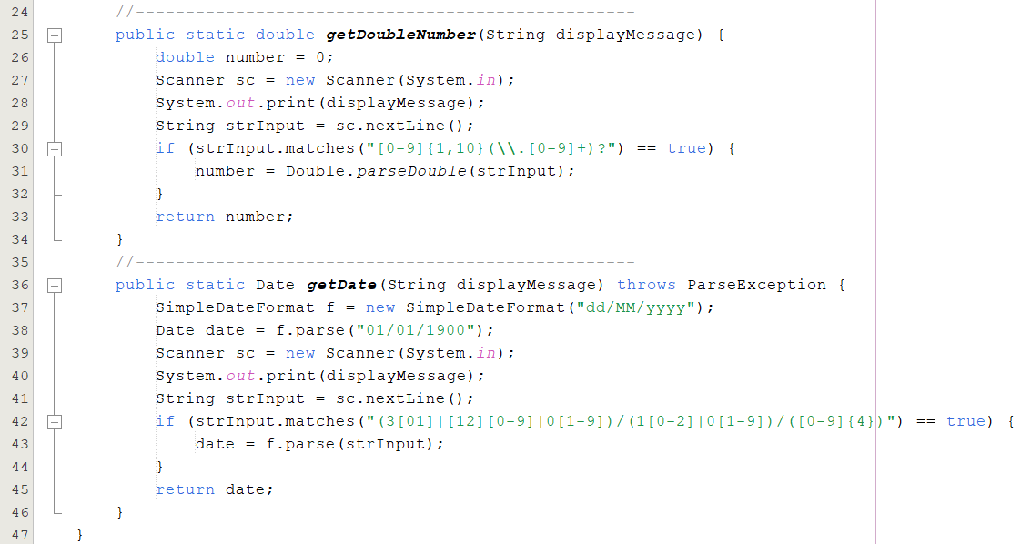
Lab

Slide 6
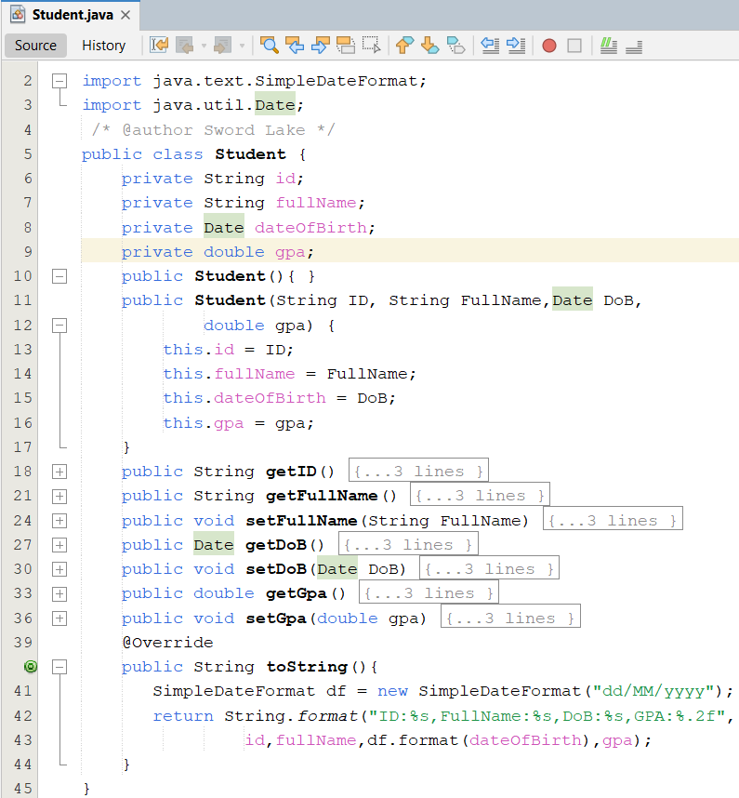
Lab
Write codes for the Student.java

Slide 7
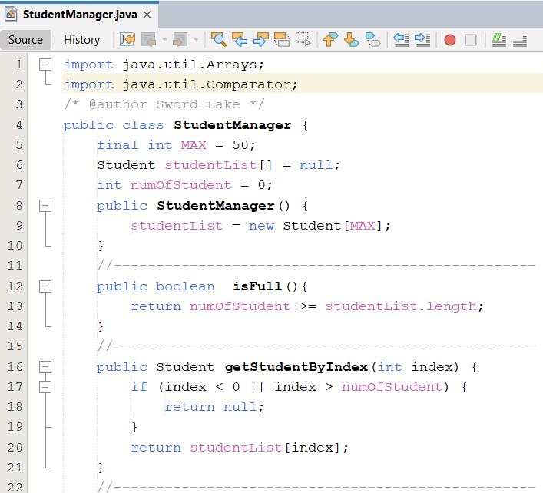
Lab
Write codes for the StudentManager.java

Slide 8
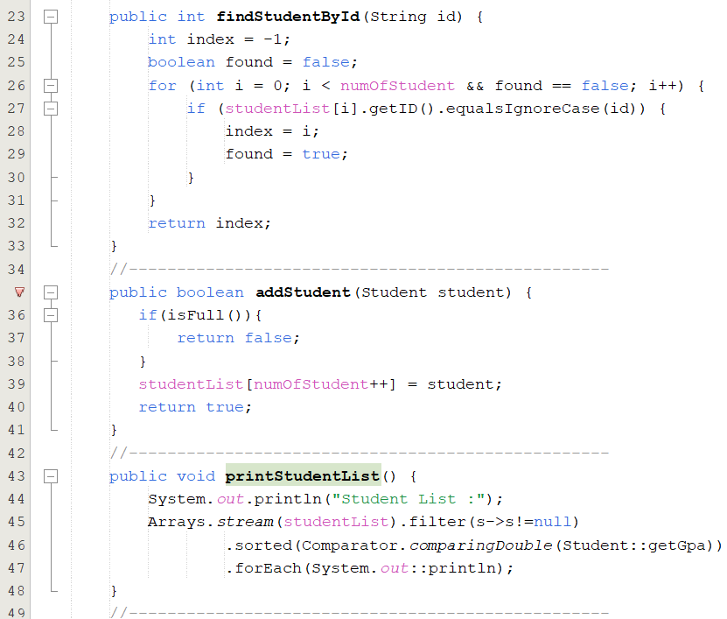
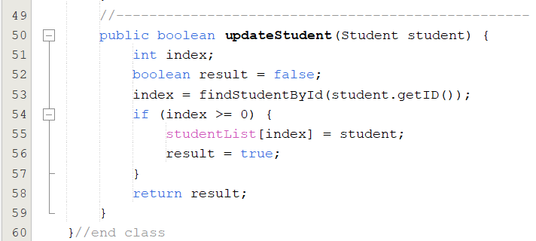
Lab

Slide 9
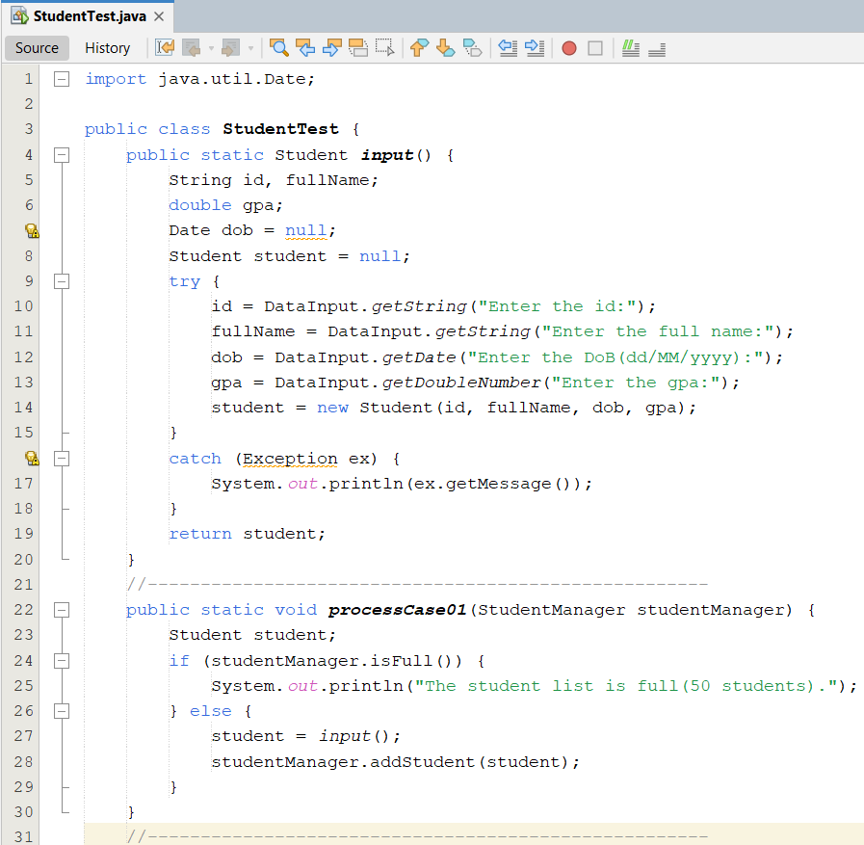
Lab
Write codes for the StudentTest.java

Slide 10
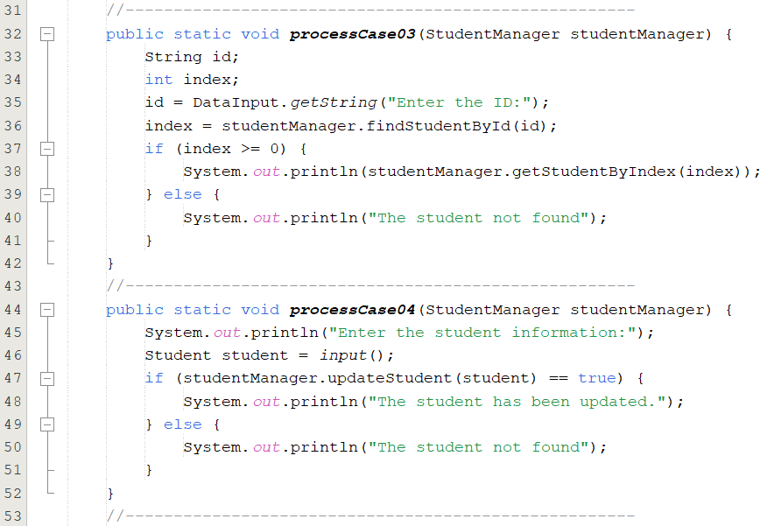
Lab

Slide 11
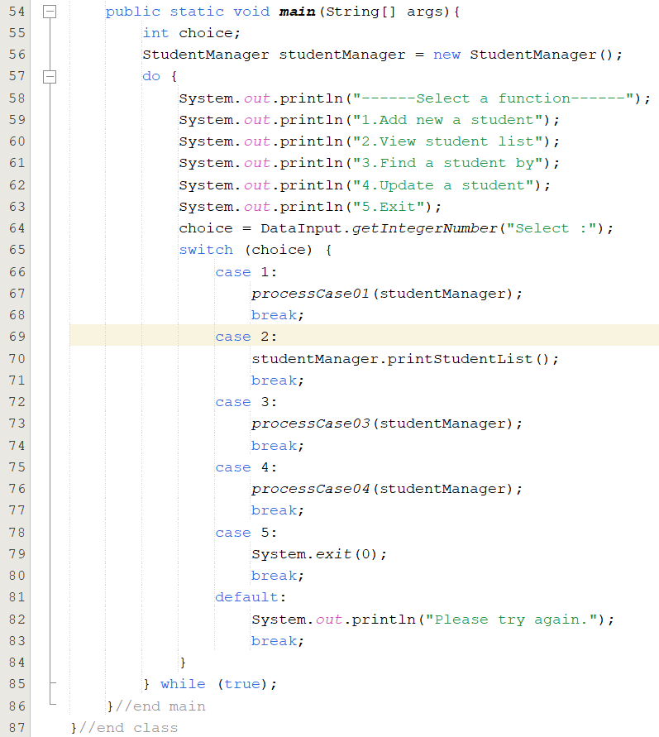
Lab

Slide 12
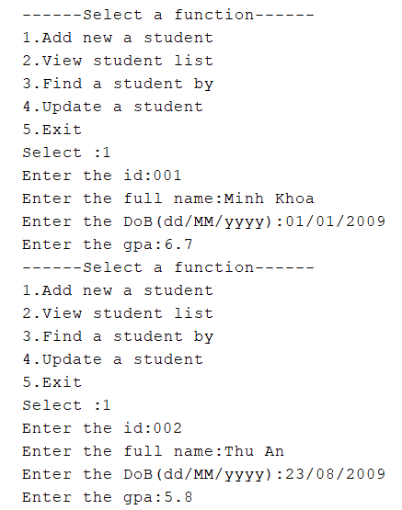
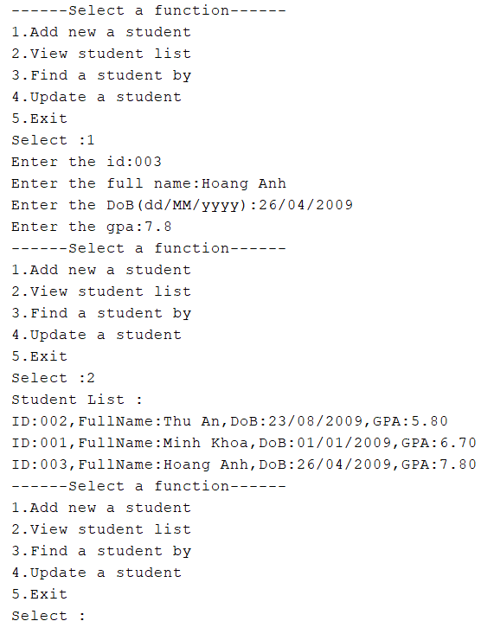
Lab

Slide 13
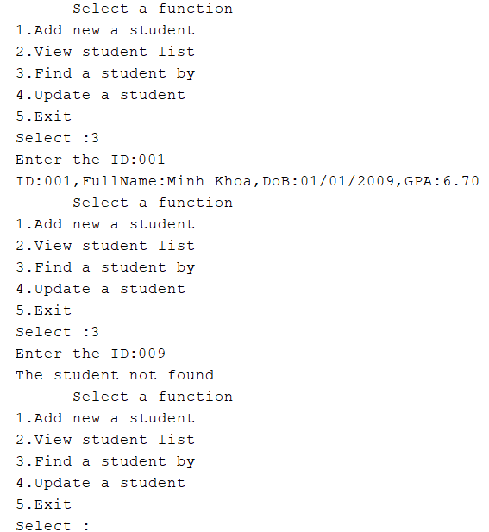
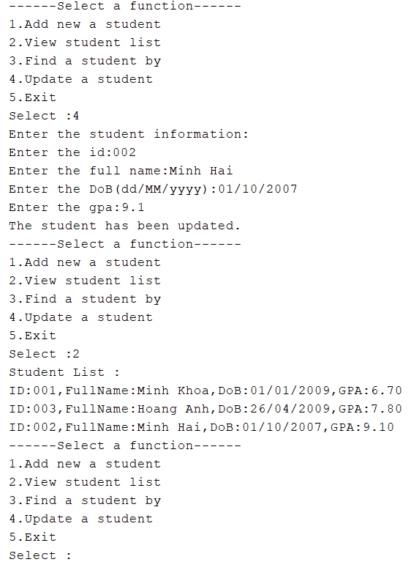
Lab

Slide 14
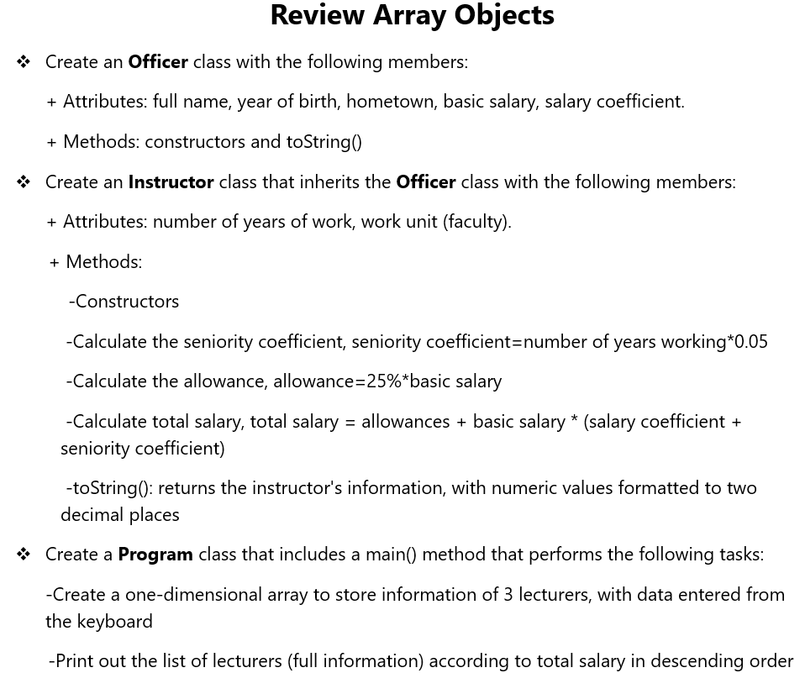
ASM

Slide 15
Case study
Problem: A antique shop that sells antique items, namely vases, statues, and paintings. The owner can add item to inventory. The shop will keep items in the list. The owner can add a new item to it, he search also the item,….
=>For now, we want to manage the list of objects such as vases, statues, paintings in an array.

Slide 16
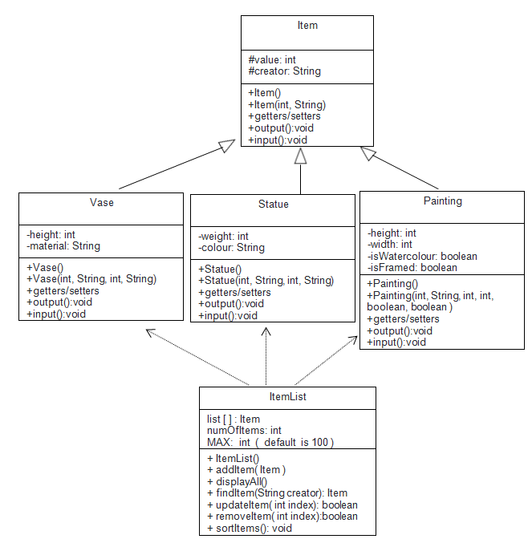
Case study

Slide 17
Case study
public abstract class Item
{
protected int value;
protected String creator;
public Item(){ value=0; creator=""; }
public Item(int value, String creator){
this.value=value;
this.creator=creator;
}
//getter
//setter
//use Scanner class to input fields
public abstract void input(); //print fields out public abstract void output();
}

Slide 18
Case study
public class Vase extends Item
{
private int height;
private String material;
//constructors
//getter
//setter
@Override
public void input(){ //use Scanner class to input fields }
@Override public void output(){ //print fields out }
@Override
public String toString(){
}
}
public class Statue extends Item
{
private int weight;
private String colour; //constructors
//getter
//setter
@Override
public void input(){ //use Scanner class to input fields }
@Override public void output(){ //print fields out }
@Override
public String toString(){
}
}

Slide 19
Case study
public class Painting extends Item
{
private int height;
private int width;
private boolean isWatercolour;
private boolean isFramed; //constructors
//getter
//setter
@Override
public void input(){ //use Scanner class to input fields }
@Override public void output(){ //print fields out }
@Override
public String toString(){
}
}

Slide 20
Case study
public class ItemList
{ Item [] list; // an array to store all items
int numOfItem; // to store the number of items that added to the list
final int MAX=100; // is the size of the array
public ItemList(){
list=new Item[MAX];
numOfItem=0;
} public boolean addItem(Item item){
if( item==null || numOfItem>=MAX)
return false;
list[numOfItem]=item;
numOfItem++;
return true;
}

Slide 21
case study
//this method prints out information of all items public void displayAll(){
if(numOfItem==0)
System.out.println("the list is empty");
for(int i=0; i< numOfItem; i++){
System.out.println(list[i]);
//or
//list[i].output();
}
}
//this method finds the item by its creator
//return the item that is found of the first occurrence.
public Item findItem(String creator){
for(int i=0; i< numOfItem; i++)
if( list[i].getCreator().equals(creator))
return list[i];
return null;
}

Slide 22
Case study
//this method returns the zero_based index of the first occurrence.
public int findItemIndex(String creator){
for(int i=0; i< numOfItem; i++)
if( list[i].getCreator().equals(creator))
return i;
return -1;
}
//this method updates the item at the specified position in this list
//input: the index you wish to update
public boolean updateItem(int index){
if( index >= 0 && index < numOfItem){
list[index].input();
return true;
}
return false;
}

Slide 23
Case study
//this method removes the item at the specified position in this list.
//Shifts any subsequent elements to the left
//input: the index you wish to remove
public boolean removeItem(int index){
if( index >= 0 && index < numOfItem){
for(int j=index; j< numOfItem; j++ ){
list[j]=list[j+1];
}
numOfItem --;
return true;
}
return false;
}

Slide 24
Case study
//this method prints out all items that belong to the given type in the list.
public void displayItemsByType(String type){
if (type.equals("Vase")){
for(int i=0; i < numOfItem; i++)
if ( list[i] instanceof Vase) System.out.println( list[i]);
}
else if (type.equals("Statue")){
for(int i=0; i < numOfItem; i++)
if ( list[i] instanceof Statue) System.out.println( list[i]);
}
else {
for(int i=0; i < numOfItem; i++)
if ( list[i] instanceof Painting) System.out.println( list[i]);
}
}

Slide 25
Case study
//this method sorts items in ascending order based on their values.
public void sortItems(){
for(int i=0; i< numOfItem; i++)
for(int j=numOfItem-1; j>i ;j--){
if( list[i].getValue()< list[j-1].getValue()){
Item tmp=list[j];
list[j]=list[j-1];
list[j-1]=tmp;
}
}
}
}//end class

Slide 26
Case study
public class antiqueShop{
public static void main(String[] args){
ItemList obj = new ItemList();
Scanner sc=new Scanner(System.in);
int choice=0;
do{
System.out.println("1. add a new vase");
System.out.println("2. add a new statue");
System.out.println("3. add a new painting");
System.out.println("4. display all items");
System.out.println("5. find the items by the creator ");
System.out.println("6. update the item by its index");
System.out.println("7. remove the item by its index");
System.out.println("8. display the list by item type [vase, statue, painting] ");
System.out.println("9. sorts items in ascending order based on their values ");
System.out.println("10. exit");
System.out.println("input your choice:");
choice=sc.nextInt();
switch(choice){

Slide 27
Case study
case 1:
Item tmp=new Vase();
tmp.input();
if(obj.addItem(tmp)){
System.out.println("added");
}
break; case 2:
…..
break case 3:
….
break; ….. }//end switch
} while(choice<=9); //end while
} //end class

